Slide 1
Treasury Banking – Money Market Operations
Bineek Raja, Vikash Anand, Vandana Sharma, Mohit Pandey
B-Tech CSE BFSI – 5th Semester

Slide 2
Abstract
Treasury department of any organization performs several tasks. In this project we will focus on the money market operations. The calculation involves of formulas which are based on parameters calculated from a set of another formula. Thus the entire process becomes complex and time consuming. We will focus on reducing the complexity by providing an automated application which will take the inputs and calculate the results efficiently. The size of data is also very large which further makes the calculation difficult task. All the formulas are implemented manually which is very tedious task for the employees of the treasury.
When the people are working in the treasury department the results must be accurate. The application will reduce the possibility of human errors by automating the calculation involved in the money market operation of the treasury department.

Slide 3
Introduction
Treasury management includes management of an enterprise's holdings, with the ultimate goal of managing the firm's liquidity and mitigating its operational, financial and reputational risk. One of the main functions of a treasury department is to control and manage the bank's money and to make sure that all parts of the bank can readily access the cash they need for their business activities.
The money market is where financial instruments with high liquidity and very short maturities are traded. It is used by participants as a means for borrowing and lending in the short term, with maturities that usually range from overnight to over year or even more than that. Money market transactions are wholesale, meaning that they are for large denominations and take place between financial institutions and organizations rather than individuals.

Slide 4
Objective
To Study Money Market Operations
To implement an application using C which can perform various Money Market Operations

Slide 5
Problem Statement
Money Market Operation has complex calculation with large amount of data size. As of now traditional method that is spread sheets are usually used to perform various money market operations. But to minimize the complexity and to make the whole process user friendly there is a need of an application which can perform all the operations.

Slide 6
Literature Review
The basic activity in the Money Market is lending. There are lot of variation seen when two banks or corporate bodies transacts between each other. These variations are result of the market scenario, socio-economic factors, risk associated, financial status of the organisation.
The lending tenure are broadly divided in the two sections, firstly less than a year and another more than one year . Since the amount is very big, treasury department handles these transactions. Calculation of simple interest, compound interest, future value and present value, interest associated with present value & future value needs to be calculated.
We will focus to compile this process under a single automated system which make the work load easier and reduce the complexity in the calculation process of the treasury department of the organisation. It will directly retrieve the required data and will save the result in the file automatically. One system will integrate the several calculations under a single software.

Slide 7
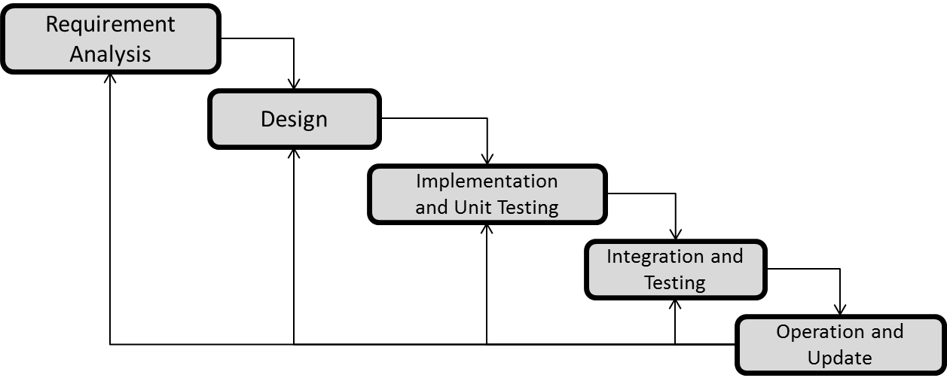
Methodology
We are using ITERATIVE WATERFALL MODEL due to large data size and complexity of our project.

Slide 9
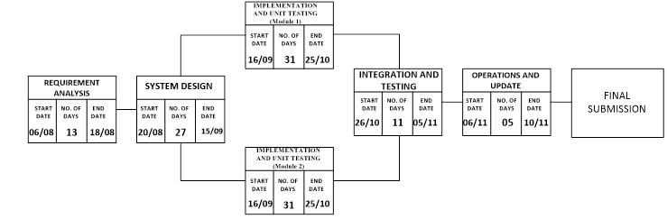
Schedule

Slide 10
References
Jae K. Shim and Joel G. Siegel, Financial Management, 3rd edition.
Roman L. Weil, Katherine Schipper and Jennifer Francis, Financial Accounting: An Introduction to Concepts, Methods and Uses, 14th edition.
Finance Trainer, Financial Mathematics Money Market

Slide 11
Thankyou

